Slide 1
CSE 583 Technology Review
911 Fire Calls
Xiaojing Xia
Nicolas Cardozo
Runbang Tang

Slide 2
Background
The problem we are trying to solve is to see how weather patterns in various parts of the city affect the type of 911 calls that are made.
We are going to study 2 different data sets.
Seattle Fire Department 911 dispatch information
Road Weather Information.
What we want to accomplish to solve this problem is to create interactive plots that will give us data points with both the weather information and the type of 911 call made in that area of the city.
Notes:
The first dataset will provide Seattle Fire Department 911 dispatch information.

Slide 3
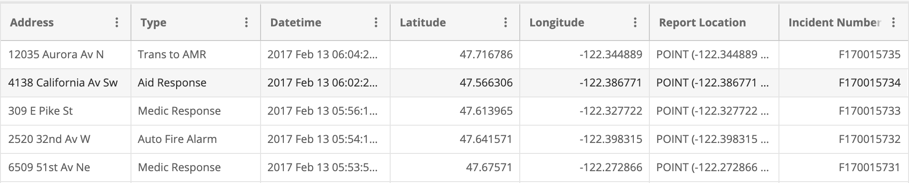
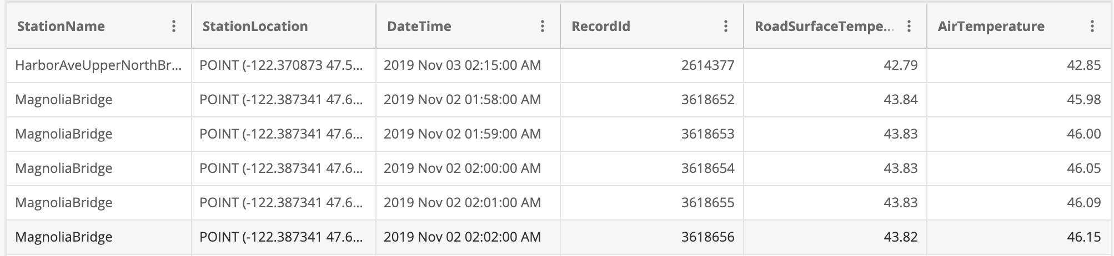
Background
Dataset 1:
Dataset 2:
Notes:
This dataset is updated every 5 minutes and has information about the address, the type of 911 call, the date, and exact location the incident occurred (longitude and latitude).
This data set will give us the road and weather temperature in the environment around the city of Seattle.

Slide 4
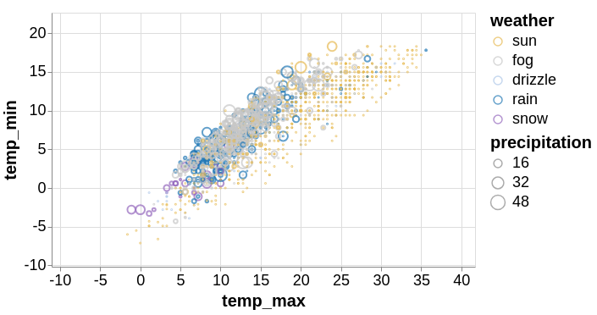
Use case
The technology we are going to be using is an interactive map visualization tool.
The main reason is that we want to be able to group our two libraries together and pull significant information from them to be able to correlate the weather patterns to the type of 911 call.
Example of plot we would like to create:
Notes:
We are going to create many option tools where the users can choose specific information they are interested in to show in the visualization and hide those unrelated data. We believe such interactive freedom can improve the versatility of the data which makes them useful to different people from different fields. For example, users can choose to show only fire alarm 911 calls which might be more interesting to people in the firefighting department. Officials from hospitals might be more curious on the 911 medic response data for medic response to try to redistribute their forces according to the geographical patterns in seattle.

Slide 5
Use case
The plots we want to create will have 3 features:
Weather
Location
Each plot will give information on the type of 911 call
Using the plots we create, we will get a better idea about the areas in the city that had more aid reponses, MVI-motor vehicle accidents, or any other of the possible 911 call types.
Notes:
Users will be able to move the plot. Click each data point and obtain

Slide 6


Potential python libraries
The potential python libraries that we are thinking about using to address our technology requirements are:
Plotly
Altair-viz
These two libraries have been chosen because they provide:
Interactive user experience
Simple to use and implement in Python
Altair
Notes:
(Can be viewed, moved around, and zoomed-in and out.)

Slide 7
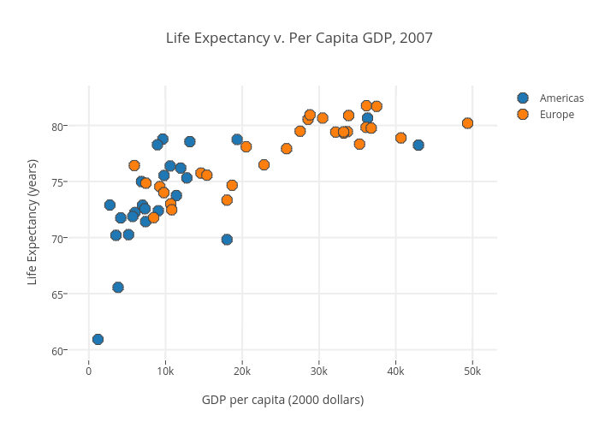
Potential python libraries
Example: Plotly
Example: Altair-viz
Notes:
Plotly supports over 40 chart types of both static and interactive graphs.

Slide 8
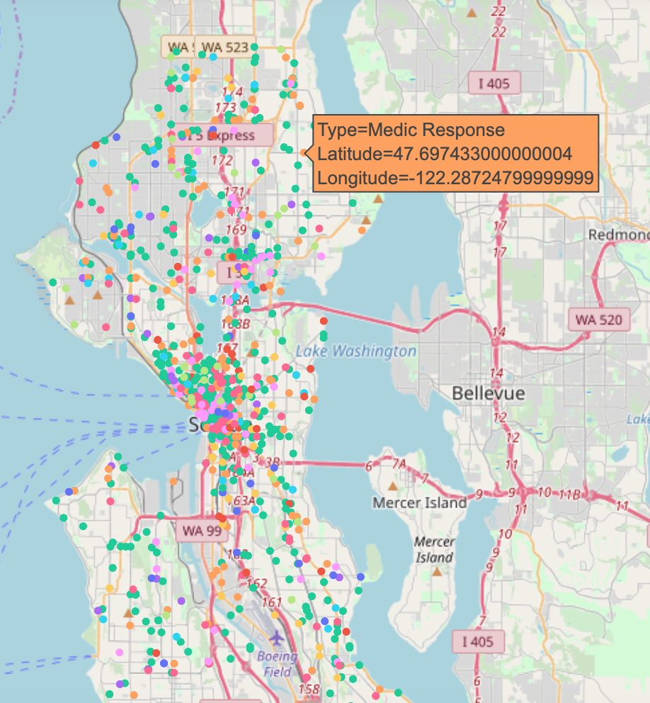
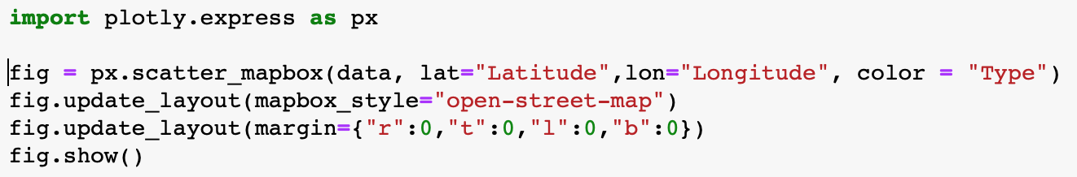
Implement Test - Plotly
Output:
Map composition - 3 types of map layers
"base map", e.g. city maps
Data layer, rendered above the base map
Top layer (optional) rendered above the data layer
Mapbox.js library is integrated into Plotly.py. Mapbox can add the base map easily to the figure.
Data inputs:
911 calls with location information (e.g. latitude and longitude)
Code:
Notes:
We did some implement test of both libraries with our dataset. Plotly is better at map visulization. In general there are 3 types is map layer

Slide 9
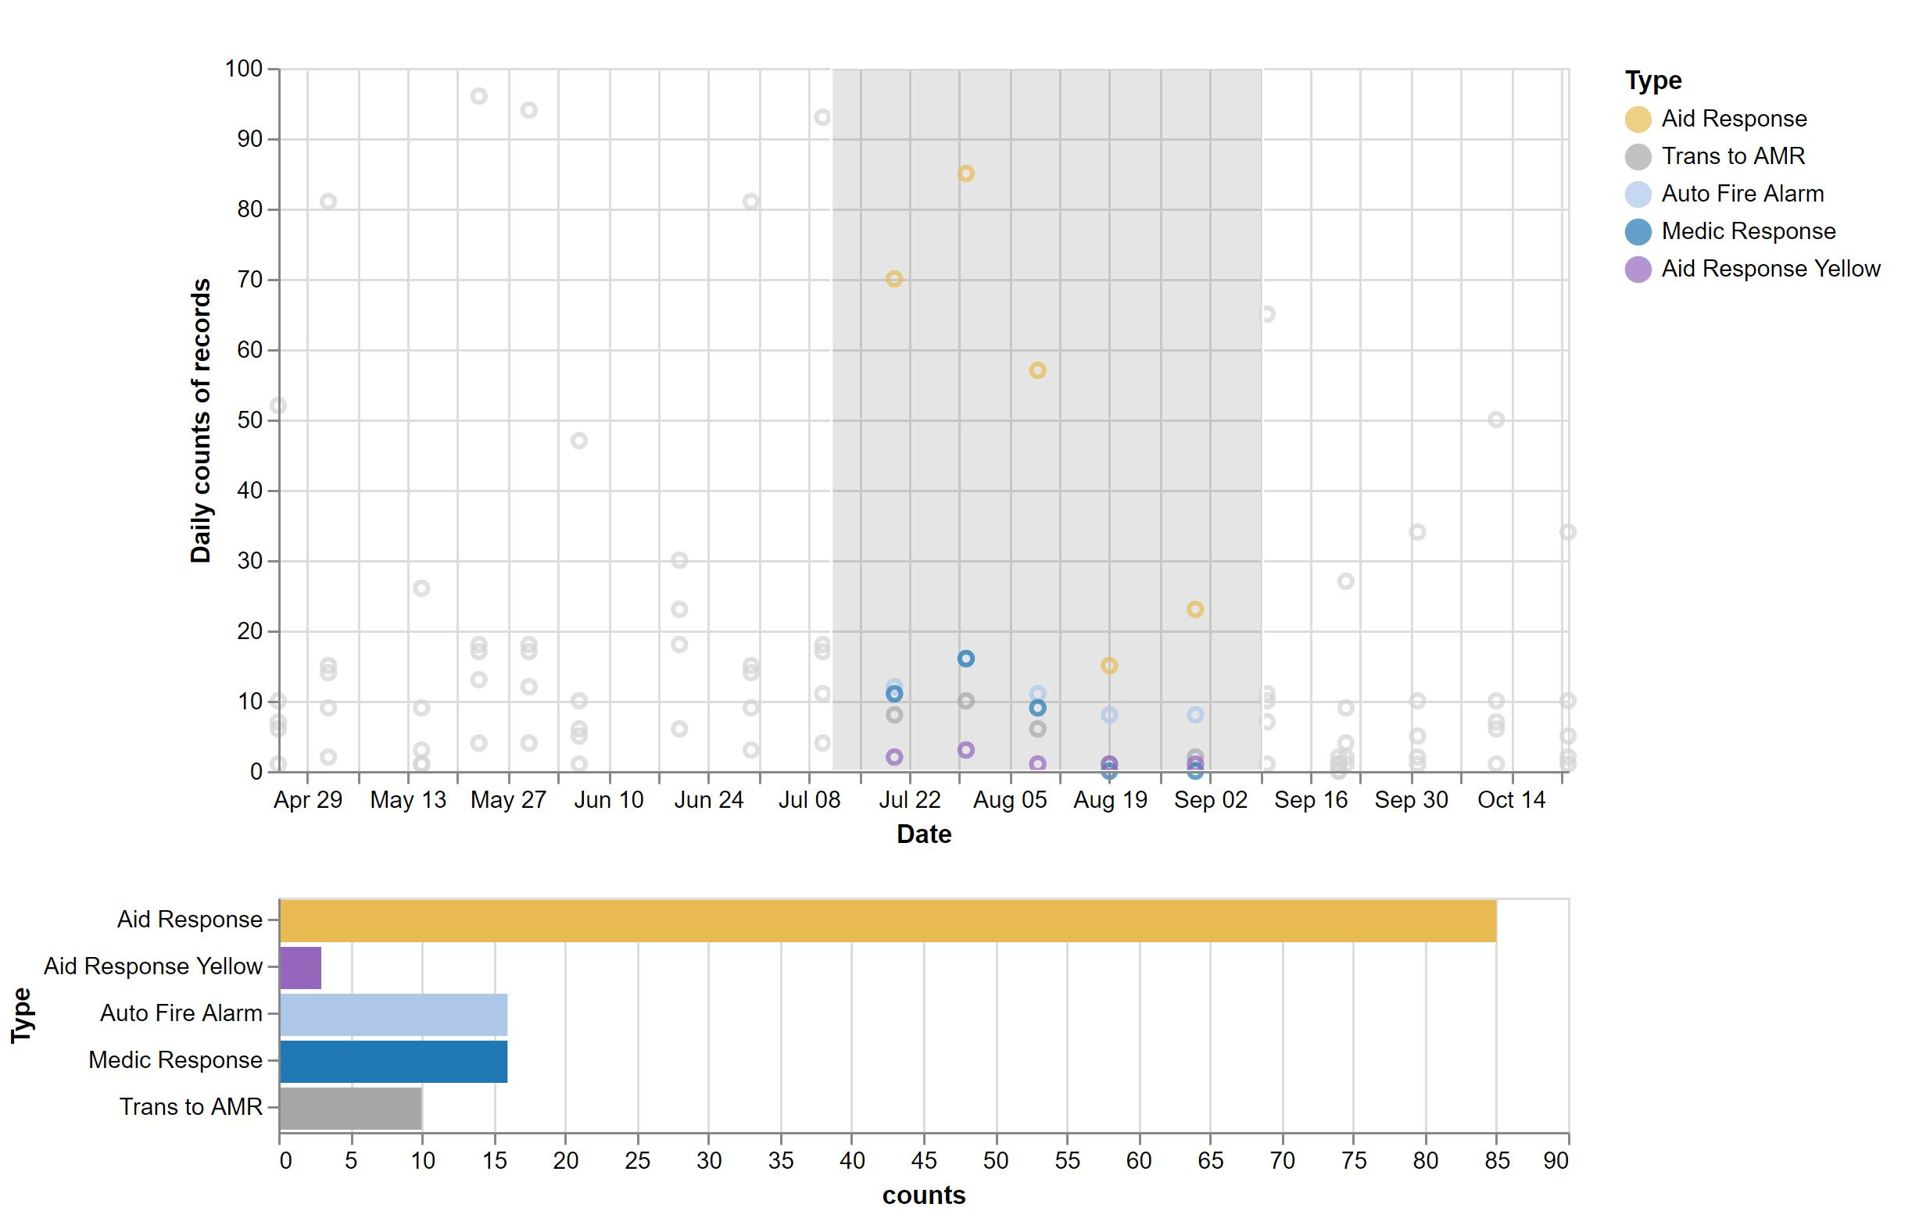
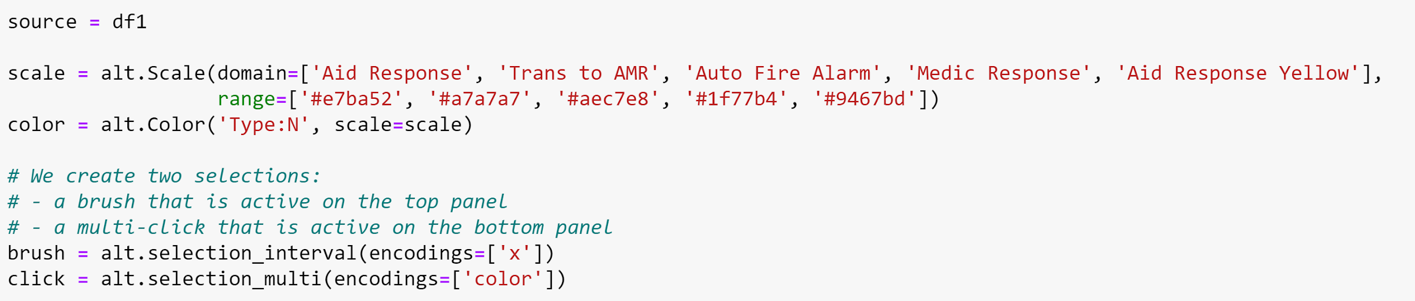
Implement Test - Altair
Graph composition - 2 types of charts
Top panel is a scatter plots of 911 call types vs dates
Bottom panel is a bar chart of counts of call types of the selected period of time
Altair-vz library is a very powerful python package to make interactive graphs that might provide clear visualization of insights among different variables
Data inputs:
First 3000 911 calls with their date and call type information
Code:
Notes:
In this implement test of altair, we are trying to show different types of 911 calls and their number of records trends from April to October. Top panel is , the bottom panel is doing.
The interactive tool here give you an option to study the specific pattern of the records in the selected time periods. In the future, we also want to create the freedom for the users to choose the specific type of calls of interest to appear on the graph. This will make the data versatile to different types of users as indicated above in the introduction

Slide 10
Comparison of the two libraries
Plotly | Altair
Easy to implement | Easy to implement
interactive | Easy for interactive graphs
Many map layer options | Not easy for map implementation

Slide 11
Thanks for your attention!
Questions?

